Slide 1
COMPUTERIZATION OF BILLING SYSTEM
Developed in JAVA with MS-Access
SUBMITTED BY

Slide 2
ABOUT COMPANY
OOPS Info. solutions Pvt. Ltd. is an Information Technology services, consulting and software company having its Headquarters in Chandigarh, India. OOPS Info. solutions is part of the OOPS Group . OOPS Info. Solutions were incorporated on December 26, 2002, as the 'Computer Maintenance Corporation Private Limited'. On August 19, 2005, it was converted into a public limited company.

Slide 3
About Project
The project is Computerization of Billing System. This project is made for any organization to manage Billing of a society.
Knowledge domain used to develop the system:
The operating system used is Windows XP. The software tools required by this project are JAVA, Ms-Access.
The project requires the knowledge of the following subjects:
Software Language: JAVA (Swings, JDBC, Threads and object serialization)
Database: Ms-Access

Slide 4
OBJECTIVES
Reduction of paper work
Automation of existing manual information systems.
Reduction of manual processing
Keep track of daily information exchange at the server by the administrator.
Increase in processing and transfer speeds of information over the network.
Decrease in processing time
Reduction of errors and viruses due to absence of internet
Keeping track that message should be delivered at the correct destination.
Fast retrieval of all type of information
Good efficiency and response time
More consistent data handling
A user-friendly system which do not require any special training or expertise of computer

Slide 5
HARDWARE & SOFTWARE REQUIRMENTS
Hardware requirements:
Processor: Pentium
RAM: 128MB
HARD DISK: 40GB
Printer: Any compatible printer
Software requirements:
JDK 1.7
Ms-Access

Slide 6
About the Java Technology
Java technology is both a programming language and a platform.
The Java Programming Language
The Java programming language is a high-level language that can be characterized by all of the following buzzwords:

Slide 7
FEATURES OF JAVA
Simple | Portable
Object oriented | Multithreaded
Distributed | High Performance
Interpreted | Robust
Secure

Slide 8
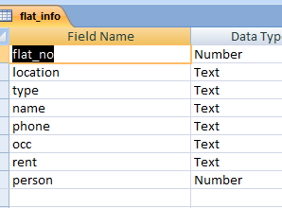
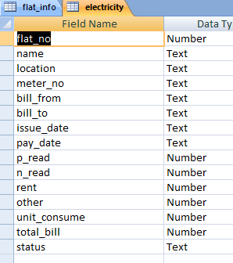
Database Design

Slide 9
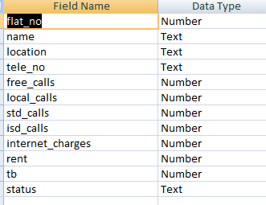
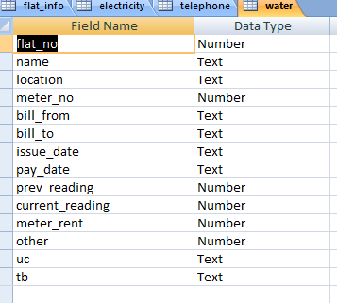

Slide 10
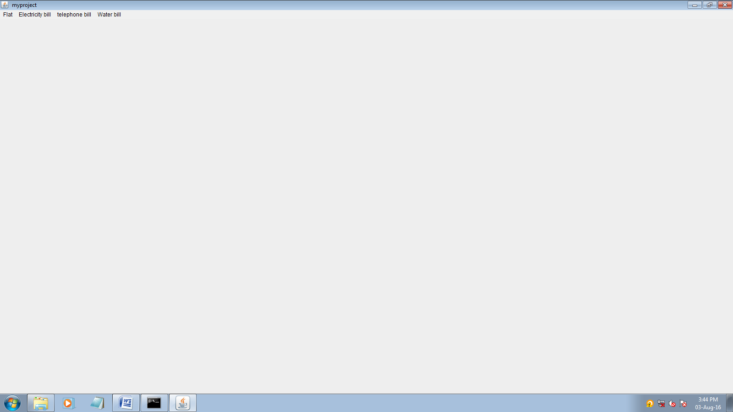
Layout Design

Slide 11
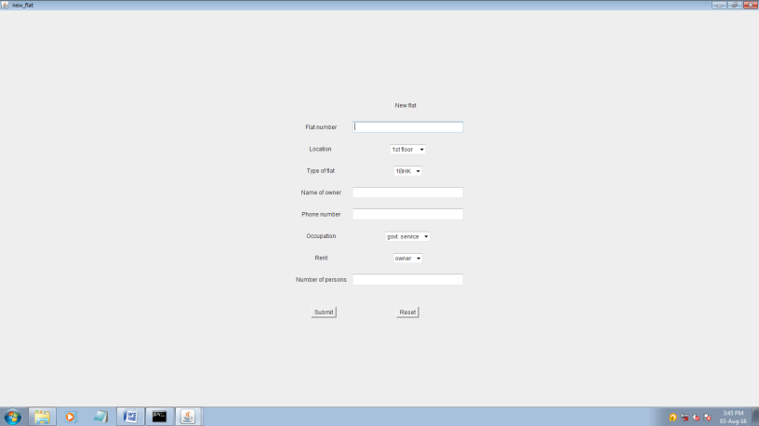
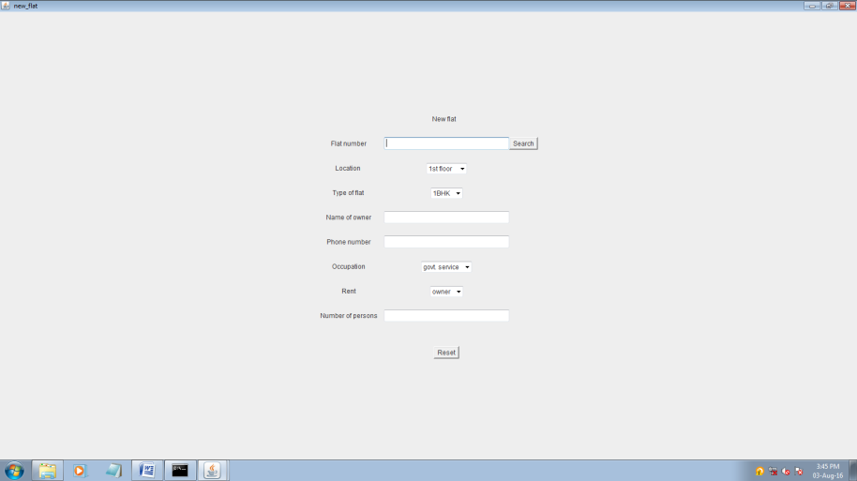

Slide 12
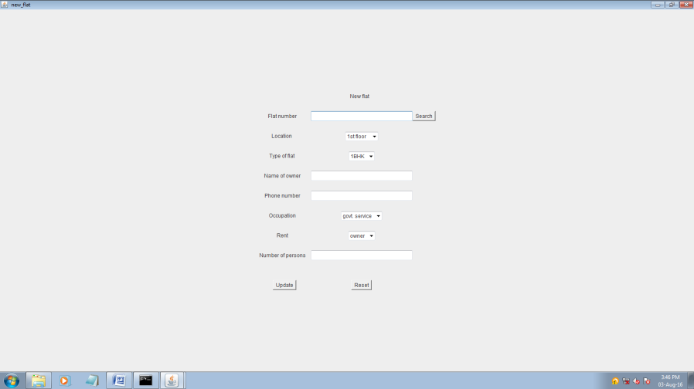
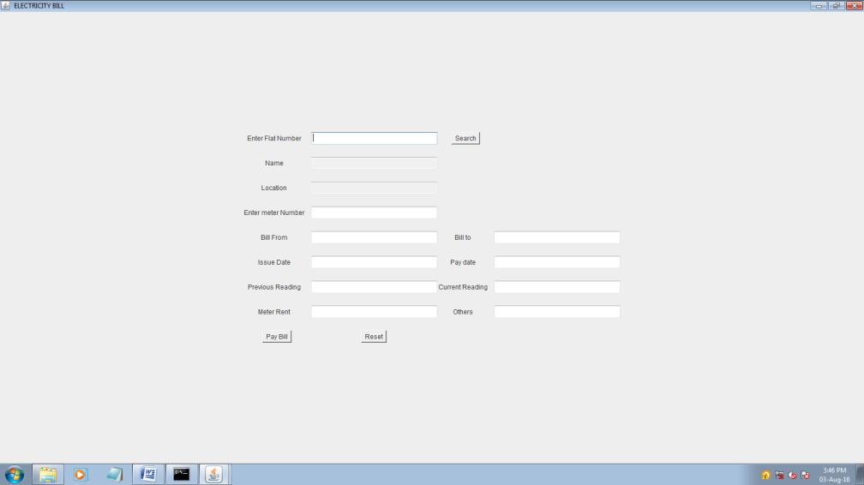

Slide 13
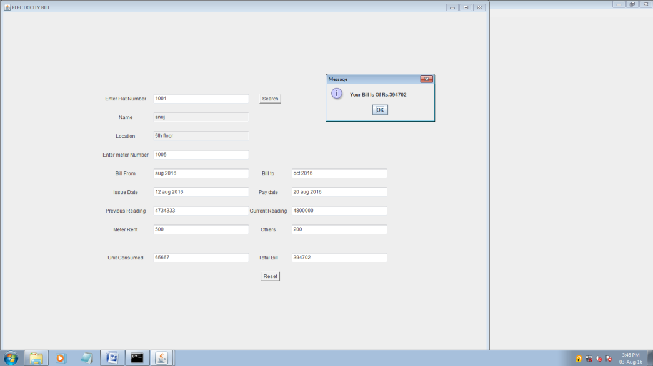
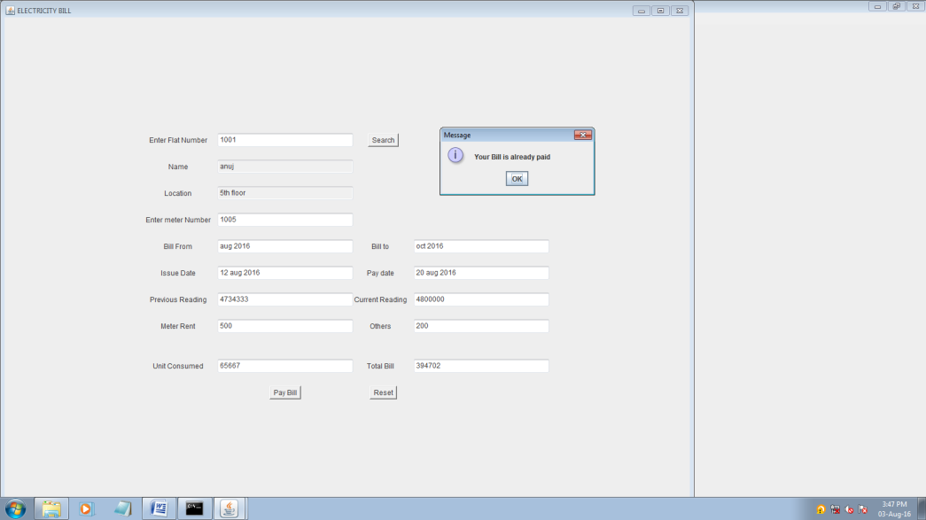

Slide 14
BIBLIOGRAPHY
The following books are being used to fulfill the requirements of the proposed project and are helpful in the understanding, development and the maintenance of the project:
Software Engineering Roger S. Pressman
java K.A.Mugal
Database System Concepts Henry F. Korth
Structured Query Language Ivan Bayros
Websites Visited:
www.java.sun.com
www.google.com

